Slide 1


Slide 2
Proverbs 8:17 (NASB)
I love those who love me; And those who diligently seek me will find me.

Slide 3
Lady Wisdom loves those who love her. Her love brings honor, riches, life, and God’s favor. What more could you want? Her love is better than rubies, silver, gold, or anything you can imagine. Do you love her? She measures your love by the priority you give her.

Slide 4
Most of the world hates Lady Wisdom (Ps 14:1-3). They love her greatest enemy – the wicked woman Folly (Pr 2:16-19). They want the world’s foolish lies and soap bubbles – gaily decorated by Hollywood, public education, the news media, and ignorant peers. They resent and despise God, wisdom, and truth. They love death.

Slide 5
But what about you? The value of Solomon’s proverbs in your life depends on what you do with them. Do you love wisdom? How do you show it? What emphasis or priority does wisdom have in your life? Do you seek her early? Do you aggressively seek her?

Slide 6
In much of chapters 8 and 9, Solomon personified wisdom as a lady offering affection and friendship. Contrasting Lady Wisdom with the strange woman Folly, he created a powerful image of two women seeking the souls of men.

Slide 7
Compare the two women and their invitations of companionship that lead to very different results (Pr 9:4-5,16-17).

Slide 8
Lady Wisdom promises love to those who love her, and she promises to be easily found by those who seek her early. If you love wisdom, she will love you back and bless your life. If you seek wisdom, you will find her easily, as she is not far from anyone (Pr 1:20-23; 8:1-5).

Slide 9
What holds back your affection and desire? Love wisdom and seek her now.

Slide 10
What does Lady Wisdom represent? What is wisdom? It is the power of right judgment, knowing the perfect response to every situation. What is its basis? The fear of the Lord! Where is wisdom most clearly defined and explained? In the Bible!

Slide 11
If a man passionately loves and emphasizes God’s word, he will gain knowledge to drastically improve his life.

Slide 12
Loving GOD Means Diligently Seeking God’s Will for Your Life, Not Your Own Will
Loving GOD Means Sacrificing Self to do His Will
Loving GOD Means Letting the HOLY SPIRIT Control Your Life
Loving GOD Means Living in Joy
Loving GOD as He Commands Opens the Window to God’s Blessings in this Life (Earth) and the Life to Come (Heaven)

Slide 13
Point #1: Loving GOD Means Diligently Seeking God’s Will for Your Life, Not Your Own Will
Luke 22:42 (NASB)
I Peter 4:2 (AMPC)
Hebrews 11:6 (KJV)

Slide 14
Luke 22:42 (NASB)
saying, "Father, if You are willing, remove this cup from Me; yet not My will, but Yours be done."

Slide 15
I Peter 4:2 (AMPC)
So that he can no longer spend the rest of his natural life living by [his] human appetites and desires, but [he lives] for what God wills.

Slide 16
Hebrews 11:6 (KJV)
But without faith it is impossible to please him: for he that cometh to God must believe that he is, and that he is a rewarder of them that diligently seek him.

Slide 17
Point #2: Loving GOD Means Sacrificing Self to do His Will
Romans 12:1-2 (KJV)
Galatians 2:20 (KJV)
Luke 9:23 (AMPC)

Slide 18
Romans 12:1-2 (KJV)
¹ Therefore thou art inexcusable, O man, whosoever thou art that judgest: for wherein thou judgest another, thou condemnest thyself; for thou that judgest doest the same things.

Slide 19
Romans 12:1-2 (KJV)
² But we are sure that the judgment of God is according to truth against them which commit such things.

Slide 20
Galatians 2:20 (KJV)
I am crucified with Christ: nevertheless I live; yet not I, but Christ liveth in me: and the life which I now live in the flesh I live by the faith of the Son of God, who loved me, and gave himself for me.

Slide 21
Luke 9:23 (AMPC)
And He said to all, If any person wills to come after Me, let him deny himself [disown himself, forget, lose sight of himself and his own interests, refuse and give up himself]

Slide 22
Luke 9:23 (AMPC)
and take up his cross daily and follow Me [cleave steadfastly to Me, conform wholly to My example in living and, if need be, in dying also].

Slide 23
Point #3: Loving GOD Means Letting the HOLY SPIRIT Control Your Life
Romans 8:12-14 (NASB)
Romans 8:5 (NASB)
I Corinthians 3:16 (NASB)

Slide 24
Romans 8:12-14 (NASB)
¹² So then, brothers and sisters, we are under obligation, not to the flesh, to live according to the flesh— ¹³ for if you are living in accord with the flesh, you are going to die; but if by the Spirit you are putting to death the deeds of the body, you will live.

Slide 25
Romans 8:12-14 (NASB)
¹⁴ For all who are being led by the Spirit of God, these are sons and daughters of God.

Slide 26
Romans 8:5 (NASB)
For those who are in accord with the flesh set their minds on the things of the flesh, but those who are in accord with the Spirit, the things of the Spirit.

Slide 27
I Corinthians 3:16 (NASB)
Do you not know that you are a temple of God and that the Spirit of God dwells in you?

Slide 28
Point #4: Loving GOD Means Living in Joy
Philippians 4:4 (NASB)
I Thessalonians 5:16 (NASB)
Galatians 5:22-23 (NASB)

Slide 29
Philippians 4:4 (NASB)
Rejoice in the Lord always; again I will say, rejoice!

Slide 30
I Thessalonians 5:16 (NASB)
Rejoice always,

Slide 31
Galatians 5:22-23 (NASB)
²² But the fruit of the Spirit is love, joy, peace, patience, kindness, goodness, faithfulness, ²³ gentleness, self-control; against such things there is no law.

Slide 32
Point #5: Loving GOD as He Commands Opens the Window to God’s Blessings in this Life (Earth) and the Life to Come (Heaven)
Malachi 3:8-10 (KJV)
Proverbs 3:5-10 (KJV)
II Corinthians 9:6-8 (KJV)
Mark 10:29-30 (AMPC)

Slide 33
Malachi 3:8-10 (KJV)
⁸ Will a man rob God? Yet ye have robbed me. But ye say, Wherein have we robbed thee? In tithes and offerings. ⁹ Ye are cursed with a curse: for ye have robbed me, even this whole nation. ¹⁰ Bring ye all the tithes into the storehouse,

Slide 34
Malachi 3:8-10 (KJV)
that there may be meat in mine house, and prove me now herewith, saith the Lord of hosts, if I will not open you the windows of heaven, and pour you out a blessing, that there shall not be room enough to receive it.

Slide 35
Proverbs 3:5-10 (KJV)
⁵ Trust in the Lord with all thine heart; and lean not unto thine own understanding.
⁶ In all thy ways acknowledge him, and he shall direct thy paths.

Slide 36
Proverbs 3:5-10 (KJV)
⁷ Be not wise in thine own eyes: fear the Lord, and depart from evil.
⁸ It shall be health to thy navel, and marrow to thy bones.

Slide 37
Proverbs 3:5-10 (KJV)
⁹ Honour the Lord with thy substance, and with the firstfruits of all thine increase:
¹⁰ So shall thy barns be filled with plenty, and thy presses shall burst out with new wine.

Slide 38
II Corinthians 9:6-8 (KJV)
⁶ But this I say, He which soweth sparingly shall reap also sparingly; and he which soweth bountifully shall reap also bountifully.
⁷ Every man according as he purposeth in his heart, so let him give; not grudgingly, or of necessity:

Slide 39
II Corinthians 9:6-8 (KJV)
for God loveth a cheerful giver.
⁸ And God is able to make all grace abound toward you; that ye, always having all sufficiency in all things, may abound to every good work:

Slide 40
Mark 10:29-30 (AMPC)
Jesus said, Truly I tell you, there is no one who has given up and left house or brothers or sisters or mother or father or children or lands for My sake and for the Gospel's

Slide 41
Mark 10:29-30 (AMPC)
Who will not receive a hundred times as much now in this time–houses and brothers and sisters and mothers and children and lands, with persecutions–and in the age to come, eternal life.

Slide 42
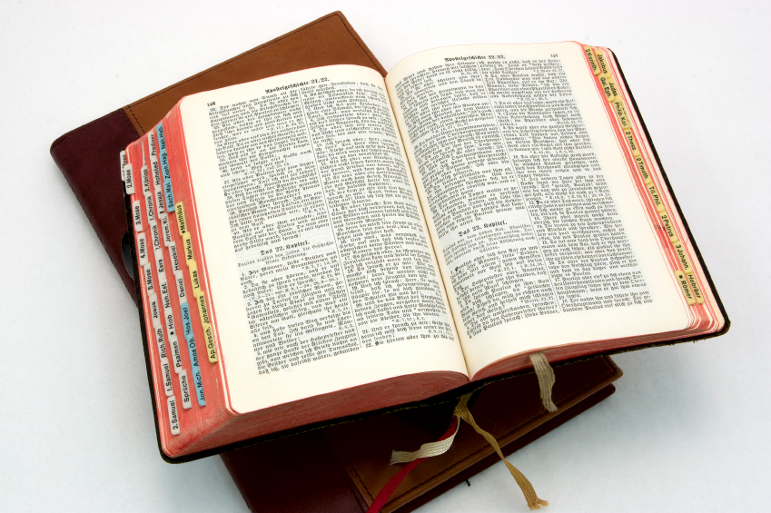
Hear: Romans 10:17
So then faith cometh by hearing, and hearing by the word of God.

Slide 43
Believe: Hebrews 11:6
But without faith it is impossible to please him: for he that cometh to God must believe that he is, and that he is a rewarder of them that diligently seek him.

Slide 44
Repent: Luke 13:3
I tell you, Nay: but, except ye repent, ye shall all likewise perish.

Slide 45
Confess: Matthew 10:32-33
32 Whosoever therefore shall confess me before men, him will I confess also before my Father which is in heaven.
33 But whosoever shall deny me before men, him will I also deny before my Father which is in heaven.

Slide 46
Baptize: Acts 22:16
And now why tarriest thou? arise, and be baptized, and wash away thy sins, calling on the name of the Lord.

